Slide 1
PROJECT REPORT
SECURE E-TENDER ALLOCATION
USING BLOCKCHAIN
Authors
Vipul Kumar
Vishwaas Saxena
Shivangi Pandey
Prof. Neha Yadav
PCSE 23-36
Department of Computer Science & Engineering
KIET Group of Institutions, Ghaziabad

Slide 2
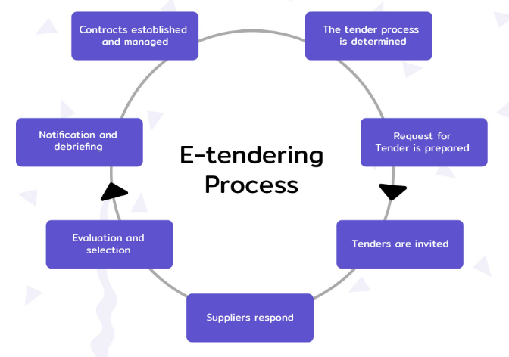
Introduction
Traditional tender allocation systems have been in use for many years but they are not without their limitations. One of the primary drawbacks of these systems is that they are often reliant on intermediaries, such as banks or third-party auditors.
This dependence on intermediaries can lead to issues such as delays, high transaction fees, and potential for fraud or corruption. Additionally, traditional tender allocation systems are often manual, paper-based processes that can be time-consuming, error-prone, and inefficient.

Slide 3
Purpose
Security
Transparency
Elimination of intermediaries.
Reduction of time and cost of the process.
Fair Score Formulation to determine a winner.

Slide 4
Approach to the problem
Smart Contract Design
Decentralized Document Storage
Consensus Algorithm
Optimal Price Formulation
Smart Contracts are legally enforceable agreements, created using operational parameters connected to a standard form of code. A smart contract is put in place to ensure that the transaction will not get added to the block until all nodes successfully verify and mark the transaction as complete.
Since most of the transactions usually involve various types of documents that need to be processed, a 3-layer file encryption model is created that allows a hassle-free and secure decentralized storage for all the required documents in a particular transaction.
We consider a network model involving multiple constructors, lenders, and tenders. Lenders propose the tender they are interested in and provide the expected time period, cost, and the period of maintenance required after the tender completion. Constructors bid on the tender and give their time period, cost, and maintenance period they can provide for the tender. The consensus is a way of reaching an agreement between the nodes.
The lenders get the best resources at the lowest prices, and the constructors get the best tenders matching to the resources they have. These formulations are not specific to a constructor, government lender, or tender.

Slide 5
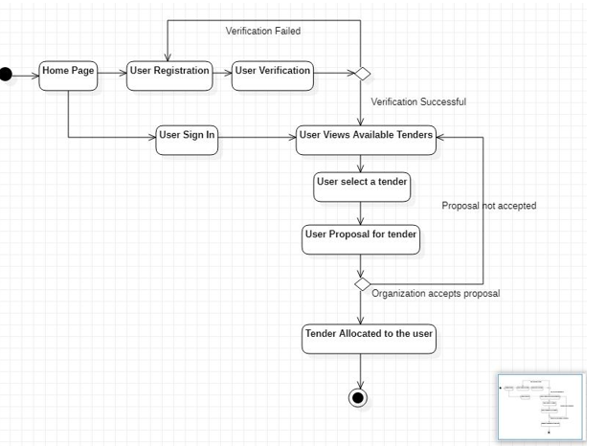
Approach to the problem
We have developed a tkinter based interface with the help of which the contractors and the bidder can communicate with the contracts.
First, the users needs to sign in as an contractor or a bidder. The contractor will have the option to create tender and upload it on the blockchain network. The contract uploaded will be available to all the bidders present on the network for which the bidders can decide whether to bid or not.
Bidders are allowed to bid only once and that to be within the time duration of the contract. Each and every bid will have a score which will be calculated using Score Formulation Parameters. After the deadline of the contract is over the bidder with the minimum score will be selected as winner of the contract.
The details of the participants and the winner of the tender will also be available only after the winner is declared.

Slide 6
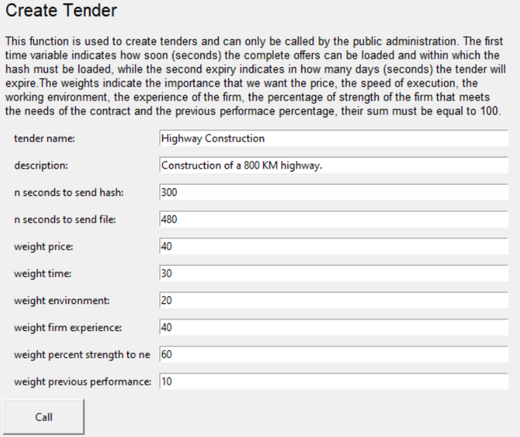
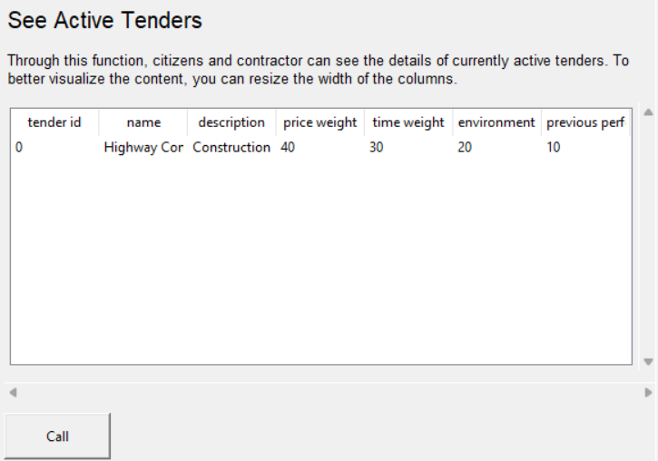
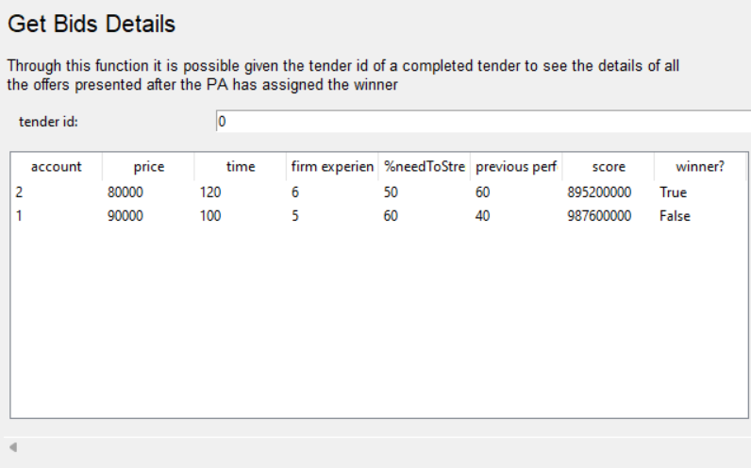
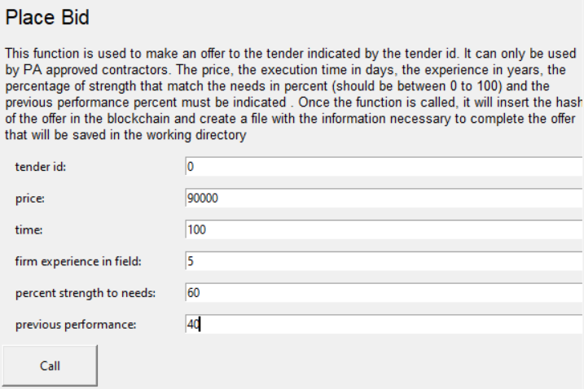

Slide 7
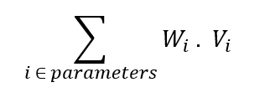
SCORE FORMULATION PARAMETERS
Price
Time
Environment
Firm Experience in the field
Percent Strength to needs
Previous Performance
Each of these parameter will have some associated weight with them based on which the scores of different bids will be calculated by multiplying their weight with their values.
Score Formulation Formula

Slide 8
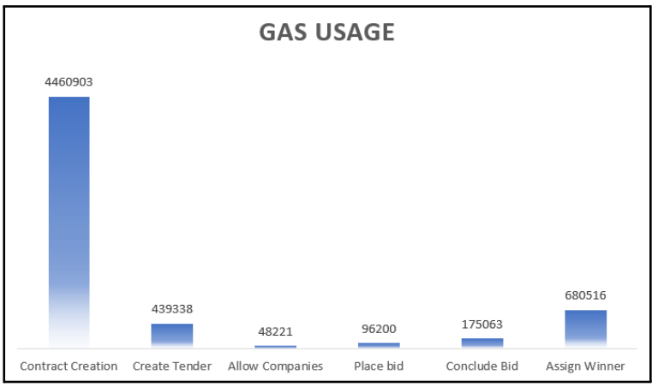
The results of the simulation showed that the blockchain-based system was able to provide a tamper-proof record of the tender process, increasing transparency and reducing the potential for fraud. Additionally, the system was found to improve efficiency by automating the process through the use of smart contracts. The smart contracts were able to ensure that all the terms of the contract were met and that the process was completed quickly
RESULTS AND ANALYSIS
Gas Usage Analysis
It gives an estimate of the complexity of various functions in the contract. It is related to the complexity of blockchain transactions. The blockchain transaction gets reverted if the transaction uses more gas than the specified gas limit. The higher the gas usage of a function, the higher will be its transaction fee.

Slide 9
CONCLUSION
In conclusion, the use of blockchain technology in e-tendering systems has the potential to revolutionize the way procurement processes are conducted. By leveraging the decentralized and immutable nature of blockchain, e-tendering systems can be made more transparent, secure, and efficient, while reducing the risk of fraud, corruption, and errors.The implementation of a blockchain-based e-tendering system would allow for a more streamlined and automated process, where all stakeholders involved in the procurement process can easily and securely share information and documents. The use of smart contracts would further automate the process, eliminating the need for intermediaries and reducing the time and cost associated with procurement.

Slide 10
THANKYOU!

